Slide 1
Basics of TDD

Slide 2
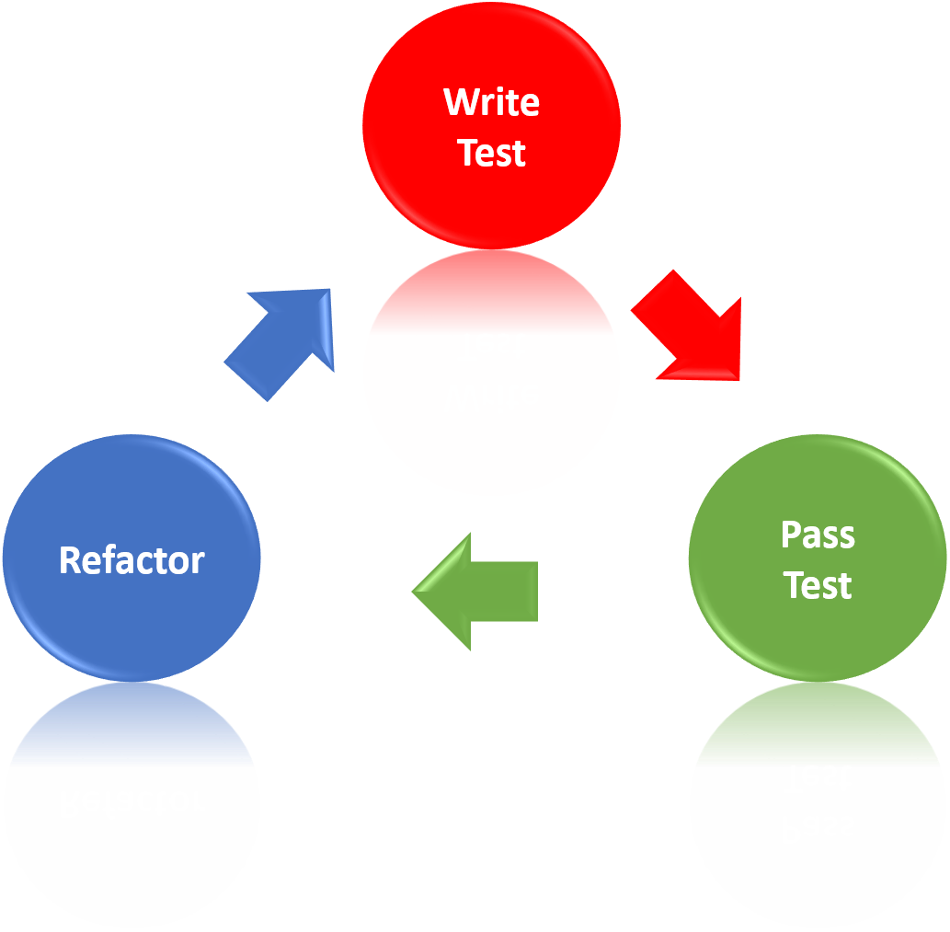
What is Test Driven Development?

Slide 3
How to do Test Driven Development?
Write the next simplest test you can think of. See it fail.
Write the simplest implementation you can think of. You are not allowed to go below 100% branch coverage! See test pass.
Refactor until you are satisfied with the code quality. Refactoring means no functional code changes. Verify this by running the tests again and checking code coverage.

Slide 4
Your exercise: Build a shopping basket
Your input is the product ID, which is scanned
Products can be added to the shopping basket
The shopping basket can be queried for the receipt
There is a repository to look up product descriptions and prices by product ID
You must provide and interface for another team to fill this repository
I’ll play the Product Owner if you have questions

Slide 5
Mob coding the first cycle
Checkout code:
git clone https://github.com/Zuehlke/tdd-workshop.git
Import into Eclipse / IntelliJ, run the empty test in BasketTest
Let’s write the simplest test
Write the simplest implementation
Refactor

Slide 6
Going forward
Follow TDD, be very strict with yourself.
Rule of thumb: If your code does not compile or tests are red over 7 actions, revert.
Implement little by little. I’ll be asking for random demonstrations while you code.
We’ll sync every ~15 minutes so nobody is stuck

Slide 7
Challenge 1
The Basket
Given
An empty basket
When
Adding a product “Wine” with price 20
Then
Basket receipt reads: “Wine: 20\nTotal: 20”
Notes:
The point here is to see that challenge 1 can NOT be implemented in a single test.
See sample solution for approach in what to test

Slide 8
Challenge 2
Adding the Scanner
Given
An item with ID 1 and description “Wine” and price 20
An item with ID 2 and description “Bread” and price 2
An empty basket
When
Scanning “Wine”
Scanning “Bread”
Then
Basket receipt reads: “Wine: 20\nBread: 2\nTotal: 22”

Slide 9
Challenge 2
Given
An item repository containing a product with ID 1, description “Wine” and price 20
When
Querying the repo with ID 1
Then
Return the product

Slide 10
Challenge 3
Summarize the same product
Given
An item with ID 1 and description “Wine” and price 20
An empty basket
When
Scanning “Wine” twice
Then
Basket receipt reads: “2 Wine: 40\nTotal: 40”

Slide 11
Challenge 4
For extra credit only!
Given
An item with ID 1 and description “Wine” and price 20
A promotion for 2x “Wine” for 35
An empty basket
When
Scanning “Wine” twice
Then
Basket receipt reads: “2 Wine: 35\nTotal: 35”

Slide 12
Review
What have you learned?
Find things you have learned.
Which things are you still missing?
What of this will you be able to use in your daily work?

